Slide 1
Binary tree, Binary search tree and Traversing
-Sivasankar Thirumalasetti

Slide 2
Sub Topics of the Presentation :
1. Binary tree
2. Binary search tree
3. Traversing

Slide 3
Binary tree
What is Binary tree ?
A tree which is having at most 2 child's is called a binary tree. If the tree is empty, then value of root is NULL.
A Tree node contains following parts.
1. Data/ Key
2. Pointer to left child 3. Pinter to right child

Slide 4
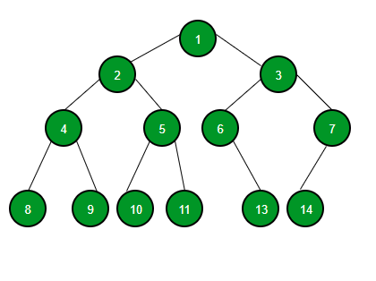
Binary tree
Root
Sub tree
Parent/child
Leaf nodes
Fig: Binary tree

Slide 5
Binary tree
Classification of Binary tree
1. Full binary tree : Every node have 2 or 0 child's, Except leaf nodes.
2. Complete binary tree : All levels are completely filled except leafs.
3. Perfect binary tree : All nodes have 2 child's and all leafs in same level.
4. Balanced binary tree : Height of each path from root is same except leafs
5. Degenerated binary tree : Each node have only child

Slide 6
What are the Binary tree terminologies
Path: Traverse from node to node along the edges results in a sequence called path
Root: A node at the top of tree . And also called as a first node in the tree
Parent :Any node which is having child's is called parent.
Leaf :A node which is doesn't have any child node is called leaf. The leafs are pointing to the NULL.
Sub tree : Any node can be connected to the root is called subtree. which consists of its child's and its child's

Slide 7
Height: The height of a node in a tree is the length of a longest path from the root to leaf.
Depth: The depth of a node is the length of a upward path from the node to the root
Level : The levels number depends on the height or depth of tree. The number of levels = height of tree – 1. The level of root node is '0'.
Null branches : The node which is pointing to the NULL is called Null branches. Number of null branches = number of nodes + 1.

Slide 8
Binary search tree
What is Binary search tree ?
Binary Search Tree is a root node-based binary tree data structure which has the following properties.
1. The left subtree of a root node contains only nodes with keys lesser than the root node’s key.
2. The right subtree of a root node contains only nodes with keys greater than the root node’s key.
3. The left and right subtree each must also be a binary search tree.

Slide 9
Binary search tree diagram
Root node
Subtree nodes
Parent/Child nodes
Leaf nodes
Fig: Binary search tree

Slide 10
Traversing a tree
Traversing a tree is three types.
1. Inorder: In preorder, first it will check to the left node than root/parent node and right node.
2. Preorder: In Inorder, first it will check present/root node than only it check left and right nodes respectively.
3. Postorder: In Preorder first it check left and right nodes respectively than it will check root/parent node.
If you want to check the tree linked properly or not, just print the data of tree in Inorder. The output of Inorder will be in ascend order.

Slide 11
Binary search tree diagram
Root node
Subtree/parent nodes
Parent/Child nodes
Leaf nodes
Fig: Binary search tree
Inorder : 1, 3, 4, 6, 7, 8, 10, 13, 14
Preoredr : 8, 3, 1, 6, 4, 7, 10, 14, 13
Postorder : 1, 4, 7, 6, 3, 8, 13, 14, 10

Slide 12
applications of trees :
Manipulate hierarchical data.
Make information easy to search (see tree traversal).
Manipulate sorted lists of data.

Slide 13
Types of trees:
1. Binary tree
2. Binary search tree
3. AVL tree
4. Red-Black tree
5. Splay tree
6. N-ary tree
7. Trie structure
8. Suffix tree
9. Huffman tree
10. Heap structure
11. Hashing tree

Slide 14
      Any queries ?

